Slide 1

Basic Descriptive Statistics
Investigation & Report

Slide 2
Topics of this lecture
Proportions & percentages
Frequency distribution
Ratios & rates

Slide 3
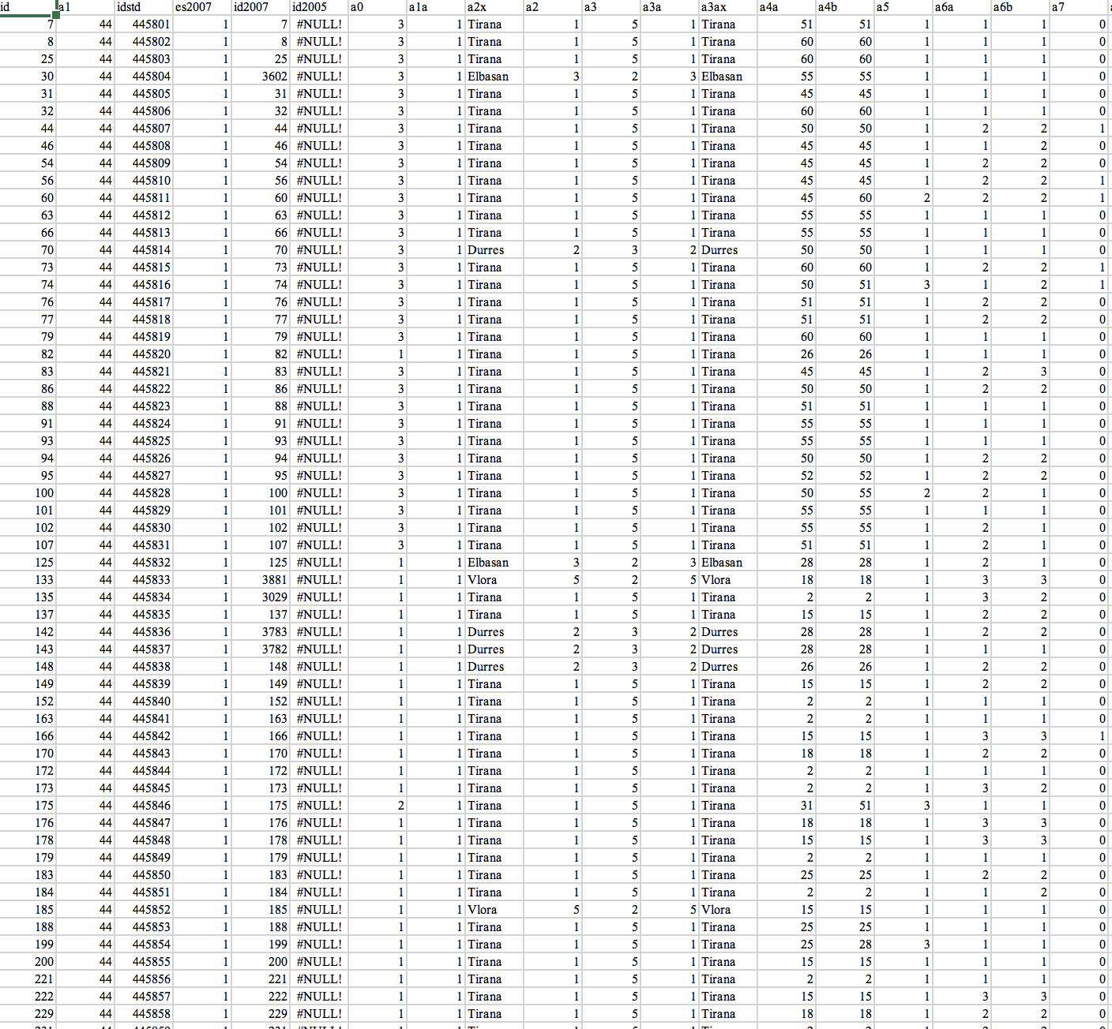
A typical Statistical Dataset

Slide 4
Descriptive Statistics
The branch of statistics that allows us to characterize & summarize our dataset based on its basic properties
Help reduce data in order to quickly & easily understand the most important characteristics of the dataset
Percentage, proportion, ratio, rate & frequency distribution; measures of central tendency and dispersion

Slide 5
Proportions & Percentages
Proportions & percentages standardize the raw data
percentages to base 100
proportions to the base 1.00
They are forceful ways of comparing groups of different sizes
Can be used to present both categorical & continuous variables
Percentage (%) = (f/N)*100
Proportion (p) – f/N
f = frequency or number of cases in any category
N = total number of cases
Example: “Of the 269 cases handled by the court, 167 resulted prison sentences of five years or more”
Proportion: 167/269 = 0.6208
Percentage: (167/269)*100 = 62.08%

Slide 6
Where is the highest percentage of urban population?
 | Urban Population
Belgium | 11,000,703
Cuba | 8,761,915
USA | 258,274,215
World | 3,848,176,659
Total Population | Urban Population (%)
11,225,207 | 98%
11,379,111 | 77%
318,857,056 | 81%
7,260,710,677 | 53%

Slide 7
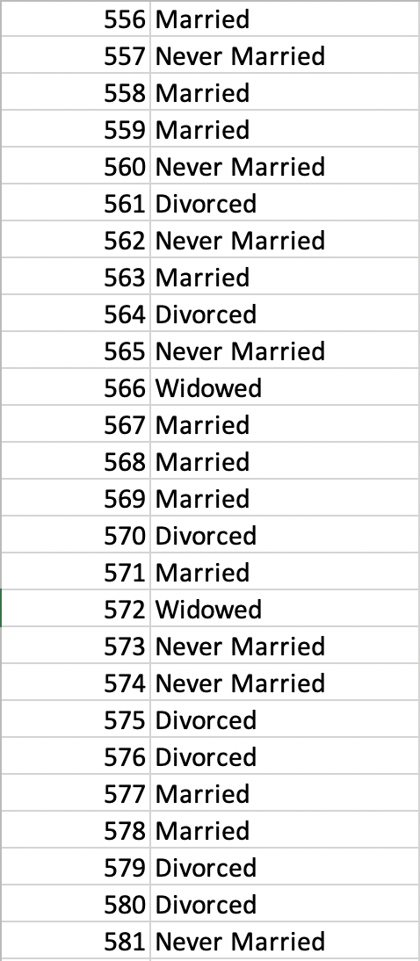
Frequency Distribution
N=1,460
Variable: Marital Status

Slide 8
Frequency Distribution
Frequency distribution: Displays the number of cases in each category of a variable
Many times, percentage frequency distributions are displayed as pie charts
Nominal-level Variable
Marital Status | Frequency | Percent frequency
Married | 661 | 45.3%
Widowed | 138 | 9.5%
Divorced | 239 | 16.4%
Separated | 43 | 2.9%
Never Married | 379 | 26%
Total | 1,460 | 100%

Slide 9
Frequency Distribution
Ordinal-level Variable
Support for Gun Control | Frequency | Percent frequency
Low | 156 | 41.7%
Medium | 123 | 32.9%
High | 95 | 25.4%
Total | 374 | 100%
Age | Frequency
Under 12 years old | 657
12-17 years old | 743
18-24 years old | 516
25-34 years old | 598

Slide 10
Reporting Percentages
With a small number of cases (especially fewer than 20), the percentages can change drastically with relatively minor changes in the data → Better to report actual frequencies
Always report the number of observations along with percentages → Be suspicious of reports that do not state the actual number of cases

Slide 11
Ratios
The number of cases in one category divided by the number of cases in some other category
Ratio=f1/f2
Number of full-time enrolled students (f1): 4,284
Number of full-time instructional faculty (f2): 269
Student to faculty ratio→ 4,284/269=16
For every professor, there are 16 students
Ratio can be expressed as sixteen to one →16:1
A community includes (f1) 1,370 Protestant families & (f2) 930 Catholic families
Protestants: 59.6% & Catholics: 40.4%
Ratio of Protestants to Catholics: 1,370/930 = 1.47
For every Catholic family, there are 1.47 Protestant families
Ratios tell us exactly how much one category outnumbers the other

Slide 12
Rates
Ratio is simply a dividend of two numbers measured in same units
A rate is a special ratio in which the two terms are in different units
Pulse rate → Number of heartbeats per minute
GDP per capita → Considered one of the indicators of a country's standard of living
Rates are often multiplied by some power of 10 to eliminate decimal points
Death rate → (# of deaths/total population)*1,000 or 100,000
Crime rate → (# of reported crimes/total population)*100,000

